Slide 1
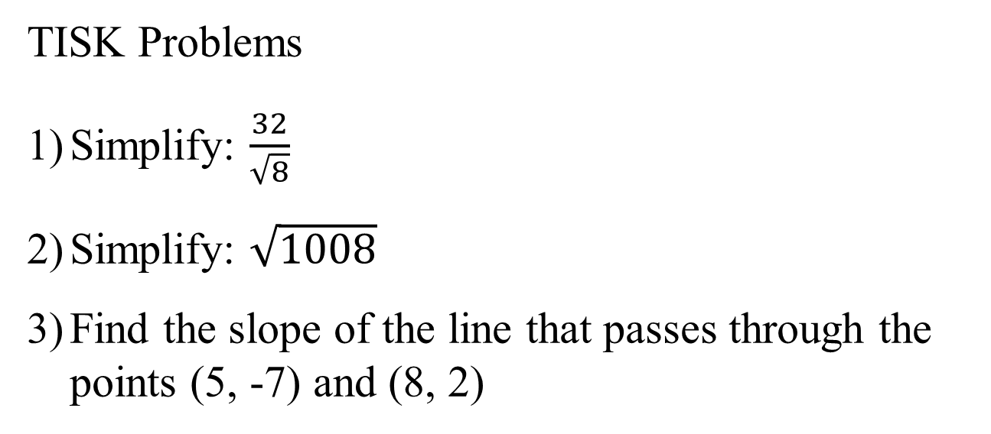
Thursday, November 8, 2012
Agenda:
TISK & No MM
Lesson 5-5: Triangle Inequalities
Homework: 5-5 Worksheet
TISK Problems
Simplify: $\frac{32}{\sqrt{8}}$
Simplify: $\sqrt{1008}$
Find the slope of the line that passes through the points (5, -7) and (8, 2)

Slide 2

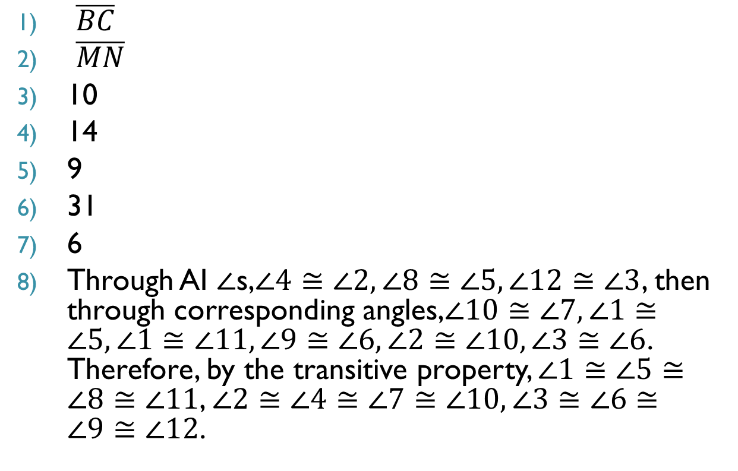
Homework Check
$\overline{BC}$
$\overline{MN}$
10
14
9
31
6
Through AI $∠$s,$∠4≅∠2, ∠8≅∠5, ∠12≅∠3$, then through corresponding angles,$∠10≅∠7, ∠1≅∠5, ∠1≅∠11, ∠9≅∠6, ∠2≅∠10, ∠3≅∠6$. Therefore, by the transitive property, $∠1≅∠5≅∠8≅∠11$, $∠2≅∠4≅∠7≅∠10, ∠3≅∠6≅∠9≅∠12$.
$D\left(2\frac{1}{2}, 0\right), E\left(7\frac{1}{2},2\right), F(5, 4)$
Work should be shown for slope and Distance Formula.
(2,8), (0, -2), and (8, 10)
(3, -1), (11, 3) and (7, 9)
40
31

Slide 3
§5.5 Inequalities in One Triangle
Theorems
If one side of a triangle is longer than another side, then the angle opposite the longer side is larger than the angle opposite the shorter side.
C
B
If $AC>BC$
Then $m∠B>m∠A$
A

Slide 4
§5.5 Inequalities in One Triangle
Theorems
If one angle of a triangle is larger than another angle, then the side opposite the longer angle is larger than the side opposite the smaller angle.
C
B
If $m∠B>m∠A$
Then $AC>BC$
A

Slide 5
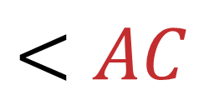
Example
Write the measurements of the sides in order from least to greatest.
C
80º
B
$$BC$$
$$<AC$$
$$<AB$$
75º
25º
A

Slide 6
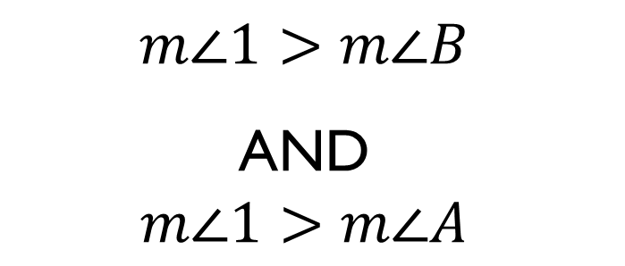
Theorems
Exterior Angle Inequality
The measure of an exterior angle of a triangle is greater than the measure of either of the two nonadjacent interior angles.
B
$$m∠1>m∠B$$
AND
$$m∠1>m∠A$$
1
C
A

Slide 7
Theorems
Triangle Inequality
The sum of the lengths of any two sides of a triangle is greater than the length of the third side.
B
$$AB+BC>AC$$
AND
C
A
$$BC+CA>AB$$
AND
$$AB+CA>BC$$

Slide 8
Finding possible side lengths.
A triangle has one side of 10 cm and another of 14 cm. Describe the possible lengths of the third side.
B
$$AB+BC>AC$$
$$AB+AC>BC$$
$$10+14>AC$$
$$10+AC>14$$
14 cm
10 cm
$$24>AC$$
$$AC>4$$
C
A
$$4<AC<24$$

Slide 9
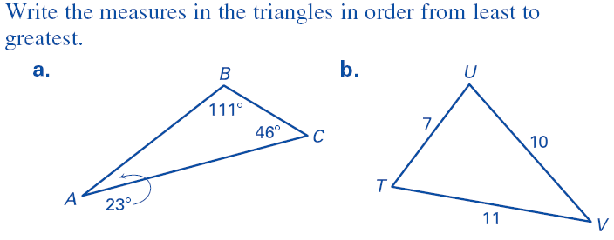
Extra Examples

Slide 10
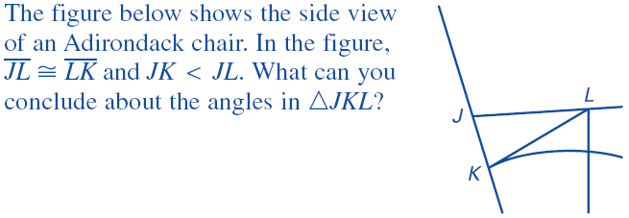
Extra Examples

